Slide 1
Managing customer contact intelligently

Slide 2
The history of Miralix
Self-developed software based on our customers’ needs
+23 years of experience with communications solutions
Independent of operators
Excellent customer service

Slide 3
Locations

Slide 4
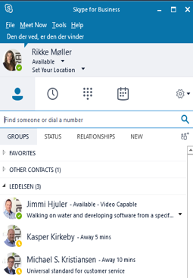
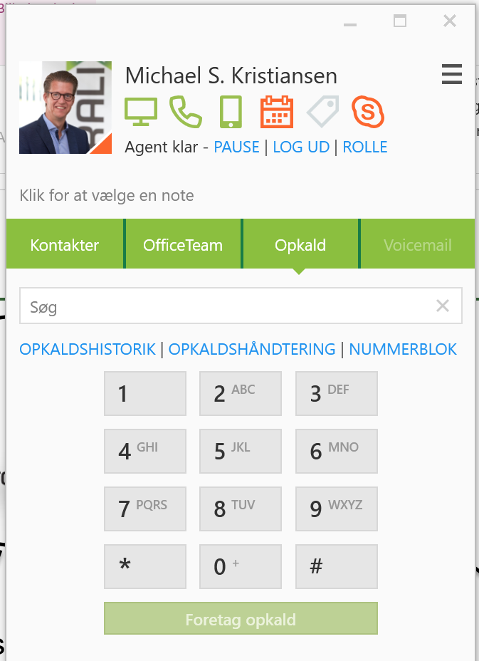
Solution types
The full contact centre solution:
+ Call transferring
+ Phone queues
+ Colleagues’ availability
+ Today’s service level
+ ‘Last spoken to’
+ Hot items
+ Call back
Receive calls via:
Mobile phone
Desk phone
Softphone
Extra functionality
+ File sharing
+ Chat
+ Video meetings
Receive calls via:
Mobile phone
Desk phone
Softphone
Softphone / IP
Reports / Business intelligence

Slide 5
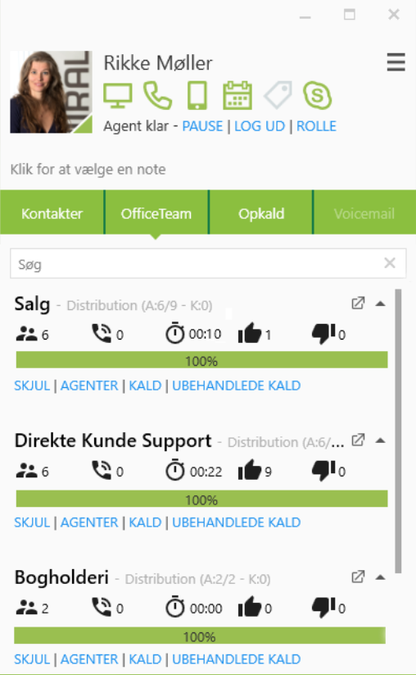
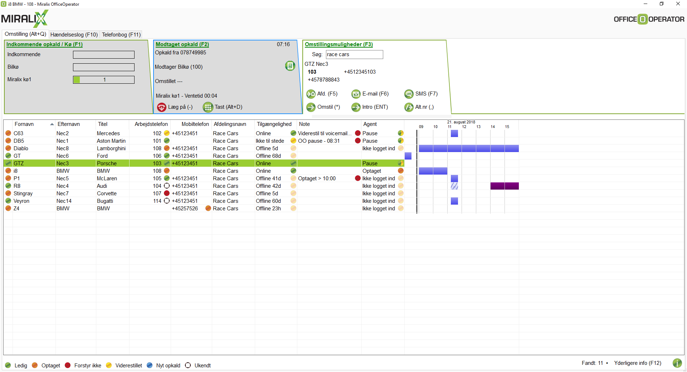
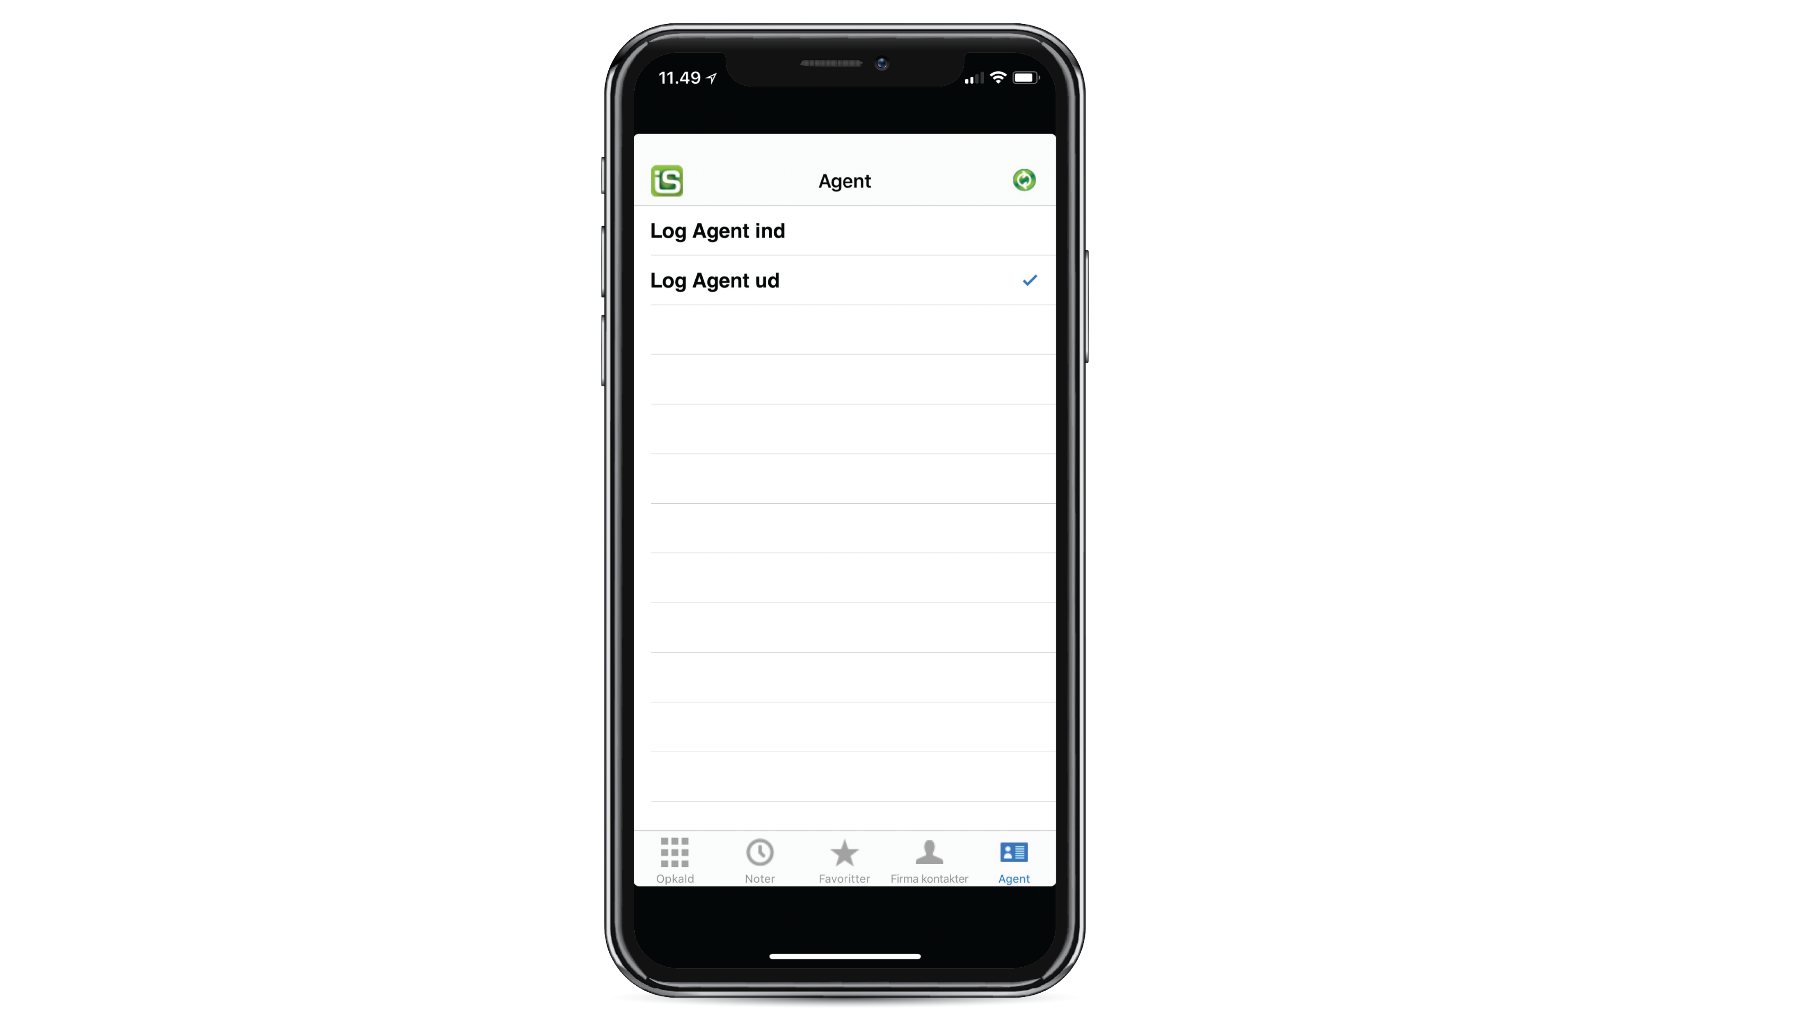
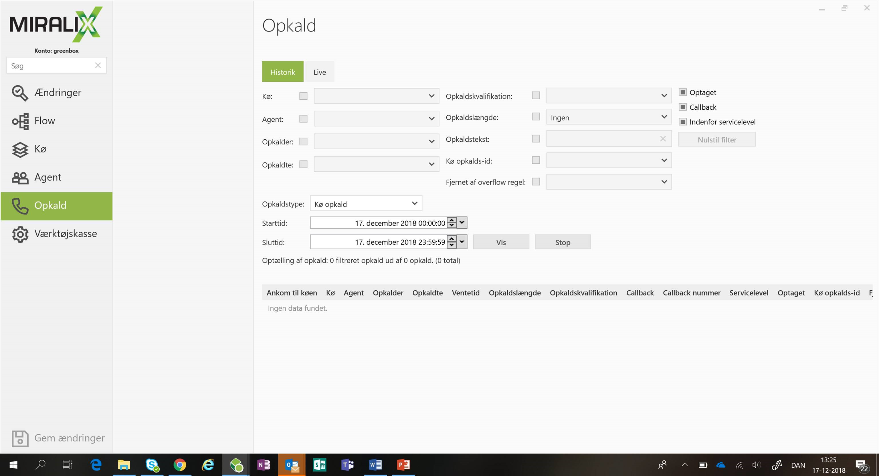
User tools
Miralix OfficeClient Agent
Miralix Attendant Console
Miralix InShare
Miralix Supervisor Access

Slide 6
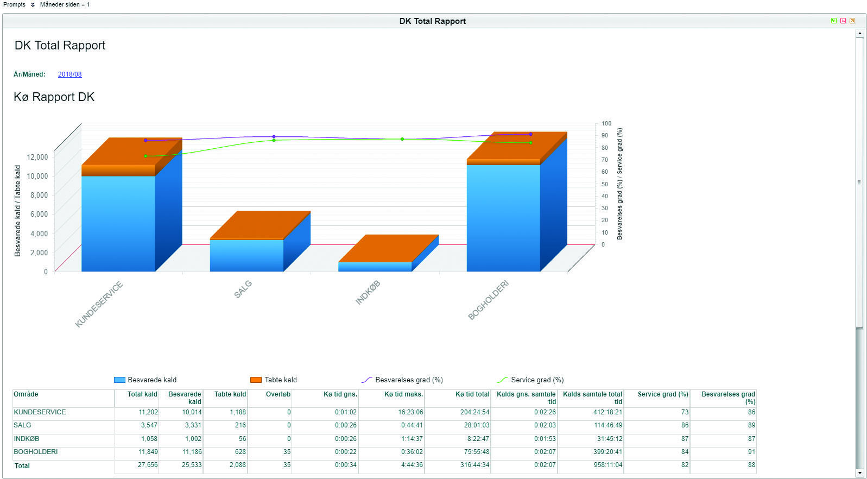
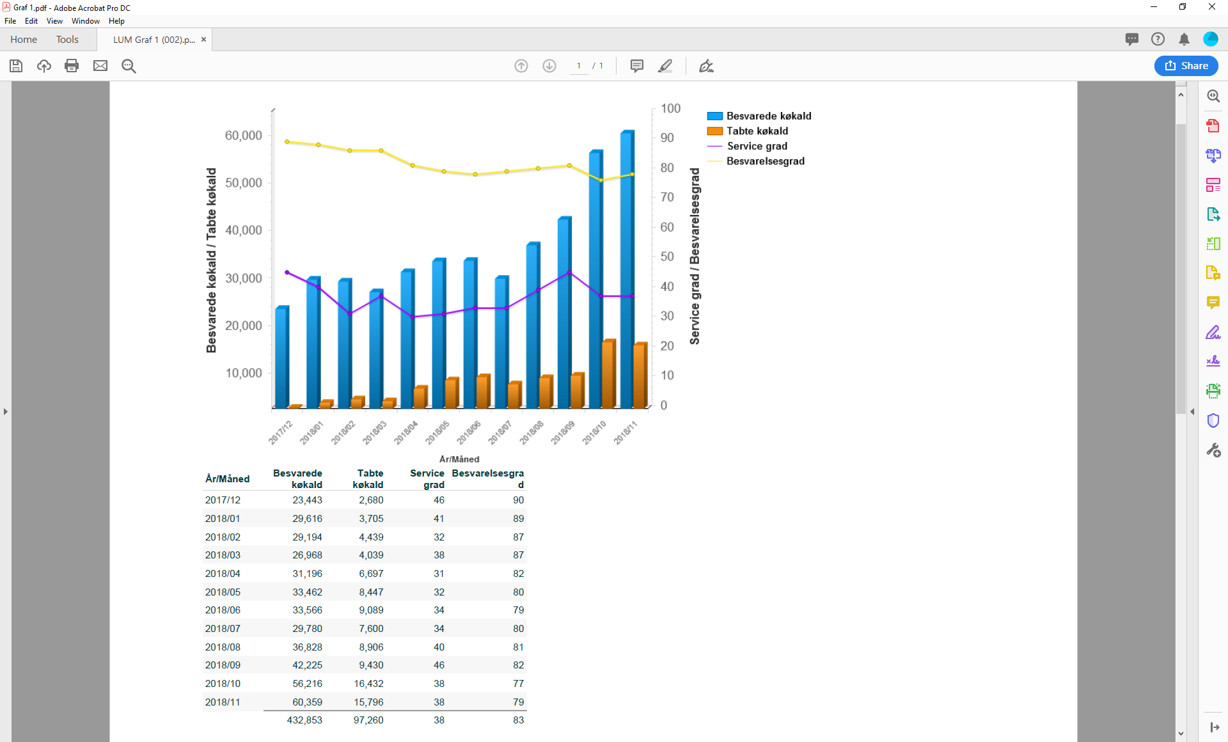
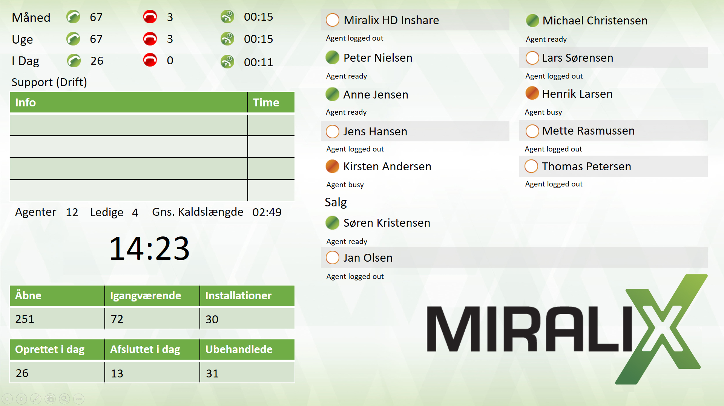
Statistics and reports
Call distribution in View Workload in View Wallboard

Slide 7
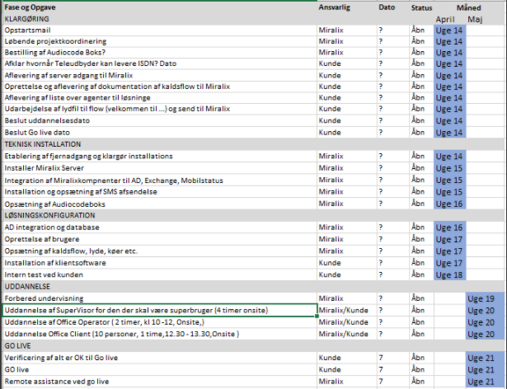
Project management
Holistic approach: 360° focus on the project
Product
• Agents
• Licences
• Software
• Sound
Processes
• Phone policy
• Documentation
• Roles
Partners
• Operators
• Consultants
• Other areas of the company
People
• New workflows
• Training
• Adaptation to new tools
• New roles

Slide 8
Service excellence
We gather feedback and requests for development through customer events
We offer project management, training and early life support as extra services.
We develop all our software in cooperation with our customers and with focus on what adds value to their businesses.
Our helpdesk, which offers English and Danish support, is available 24/7.

